Slide 1
The Laws of Motion

Slide 2
The Laws of Motion
The description of an object in motion included its position, velocity, and acceleration.
There was no consideration of what might influence that motion.
Two main factors need to be addressed to answer questions about why the motion of an object will change.
  Forces acting on the object
  The mass of the object
Dynamics studies the causes of motion.
Will start with three basic laws of motion
  Formulated by Sir Isaac Newton

Slide 3
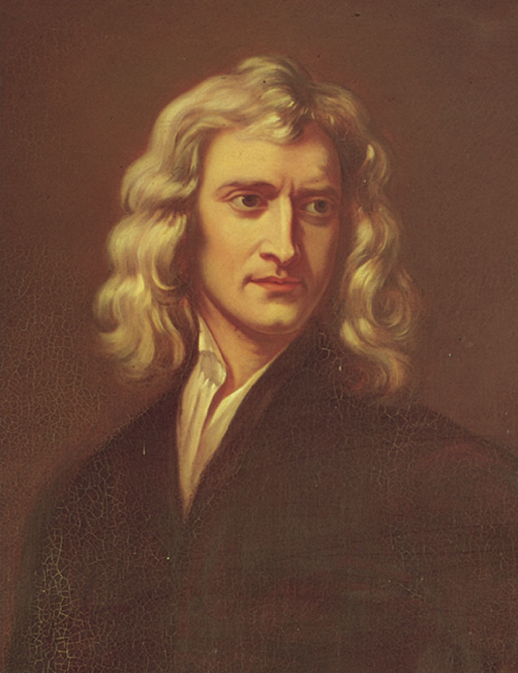
Sir Isaac Newton
1642 – 1727
Formulated basic laws of mechanics
Discovered Law of Universal Gravitation
Invented form of calculus
Many observations dealing with light and optics

Slide 4
Force
Forces in everyday experience
  Push on an object to move it
  Throw or kick a ball
  Note: You may push on an object and not be able to move it
Forces are what cause any change in the velocity of an object.
  Newton’s definition
  A force is that which causes an acceleration

Slide 5
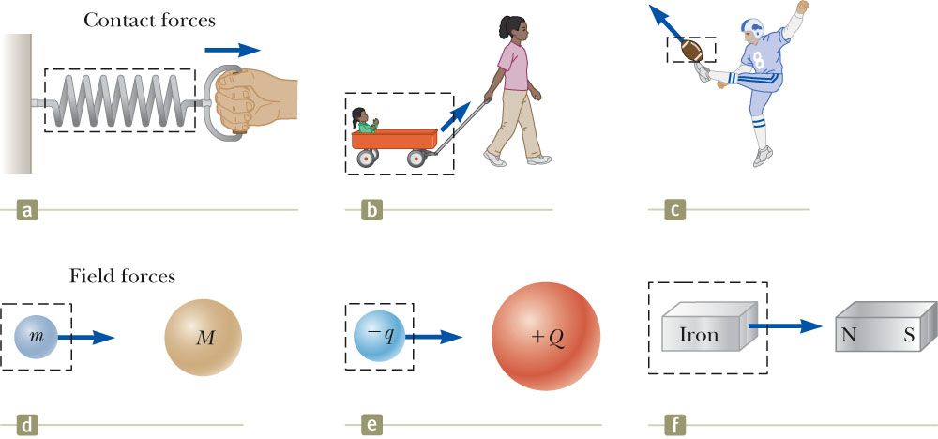
Classes of Forces
Contact forces involve physical contact between two objects
  Examples a, b, c
Field forces act through empty space
  No physical contact is required
  Examples d, e, f

Slide 6
Fundamental Forces
Gravitational force
  Between objects
Electromagnetic forces
  Between electric charges
Nuclear force
  Between subatomic particles
Weak forces
  Arise in certain radioactive decay processes
Note: These are all field forces.

Slide 7
Newton’s First Law
If an object does not interact with other objects, it is possible to identify a reference frame in which the object has zero acceleration.
  This is also called the law of inertia.
  It defines a special set of reference frames called inertial frames.
    We call this an inertial frame of reference.

Slide 8
Inertial Frames
Any reference frame that moves with constant velocity relative to an inertial frame is itself an inertial frame.
If you accelerate relative to an object in an inertial frame, you are observing the object from a non-inertial reference frame.
A reference frame that moves with constant velocity relative to the distant stars is the best approximation of an inertial frame.
  We can consider the Earth to be such an inertial frame, although it has a small centripetal acceleration associated with its motion.

Slide 9
Newton’s First Law – Alternative Statement
In the absence of external forces, when viewed from an inertial reference frame, an object at rest remains at rest and an object in motion continues in motion with a constant velocity.
  Newton’s First Law describes what happens in the absence of a force.
    Does not describe zero net force
  Also tells us that when no force acts on an object, the acceleration of the object is zero
  Can conclude that any isolated object is either at rest or moving at a constant velocity
The First Law also allows the definition of force as that which causes a change in the motion of an object.

Slide 10
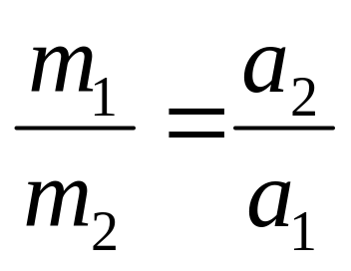
Inertia and Mass
The tendency of an object to resist any attempt to change its velocity is called inertia.
Mass is that property of an object that specifies how much resistance an object exhibits to changes in its velocity. Appropriately, it is referred to as inertial mass
Masses can be defined in terms of the accelerations produced by a given force acting on them:
  The magnitude of the acceleration experienced by an object is inversely proportional to its mass.

Slide 11
More About Mass
Mass is an inherent property of an object.
Mass is independent of the object’s surroundings.
Mass is independent of the method used to measure it.
Mass is a scalar quantity.
  Obeys the rules of ordinary arithmetic
The SI unit of mass is kg.

Slide 12
Mass vs. Weight
Mass and weight are two different quantities.
Weight is equal to the magnitude of the gravitational force exerted on the object, i.e. W=mg.
  Weight will vary with location.

Slide 13
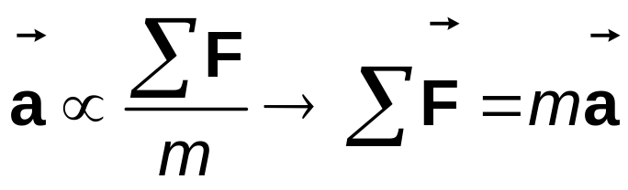
Newton’s Second Law
When viewed from an inertial reference frame, the acceleration of an object is directly proportional to the net force acting on it and inversely proportional to its mass.
  Force is the cause of changes in motion, as measured by the acceleration.
    Remember, an object can have motion in the absence of forces.
Algebraically,
  With a proportionality constant of 1 and speeds much lower than the speed of light.

Slide 14
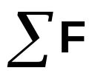
More About Newton’s Second Law
is the net force
  This is the vector sum of all the forces acting on the object.
    May also be called the total force, resultant force, or the unbalanced force.
Newton’s Second Law can be expressed in terms of components:
  ΣF_{x} = m a_{x}
  ΣF_{y} = m a_{y}
  ΣF_{z} = m a_{z}
Remember that ma is not a force.
  The sum of the forces is equated to this product of the mass of the object and its acceleration.

Slide 15
Units of Force
The SI unit of force is the newton (N).
  1 N = 1 kg·m / s²
That is, one newton is the force that which causes 1 kg mass to accelerate at 1 m/ s²

Slide 16
Force of Friction

Slide 17
Forces of Friction
When an object is in motion on a surface or through a viscous medium, there will be a resistance to the motion.
  This is due to the interactions between the object and its environment.
This resistance is called the force of friction.
There are two types of friction:
-static friction
-kinetic friction

Slide 18
Forces of Friction, cont’d.
Friction is proportional to the normal force.
  f_{s} = µ_{s} n and f_{k}= µ_{k} n
    μ is the coefficient of friction
  These equations relate the magnitudes of the forces; they are not vector equations.
  For static friction, the equals sign is valid only at impeding motion, the surfaces are on the verge of slipping.
  Use the inequality for static friction if the surfaces are not on the verge of slipping.

Slide 19
Forces of Friction, final
The coefficient of friction depends on the nature of surfaces in contact.
The force of static friction is generally greater than the force of kinetic friction.
The direction of the frictional force is opposite the direction of motion and parallel to the surfaces in contact.
The coefficients of friction are nearly independent of the area of contact.
Note: The above statements are usually referred to as the laws of friction

Slide 20
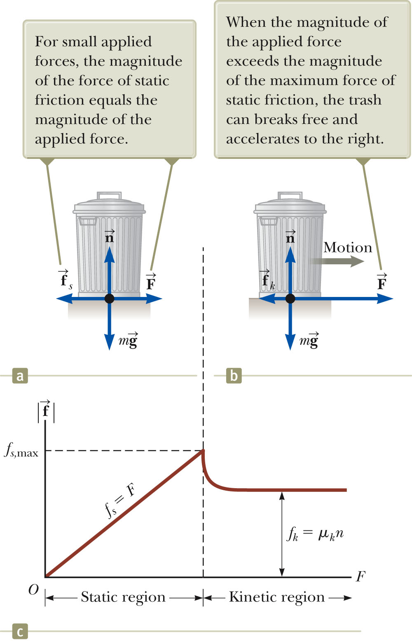


Static Friction
Static friction acts to keep the object from moving.
As long as the object is not moving, ƒ_{s} = F
If increases, so does
If decreases, so does
ƒ_{s} ≤ µ_{s} n means Static Friction
  Remember, the equality holds when the surfaces are on the verge of slipping.

Slide 21
Kinetic Friction
The force of kinetic friction acts when the object is in motion.
Although µ_{k} can vary with speed, we shall neglect any such variations.
ƒ_{k} = µ_{k} n

Slide 22
Explore Forces of Friction
Vary the applied force
Note the value of the frictional force
  Compare the values
Note what happens when the can starts to move

Slide 24
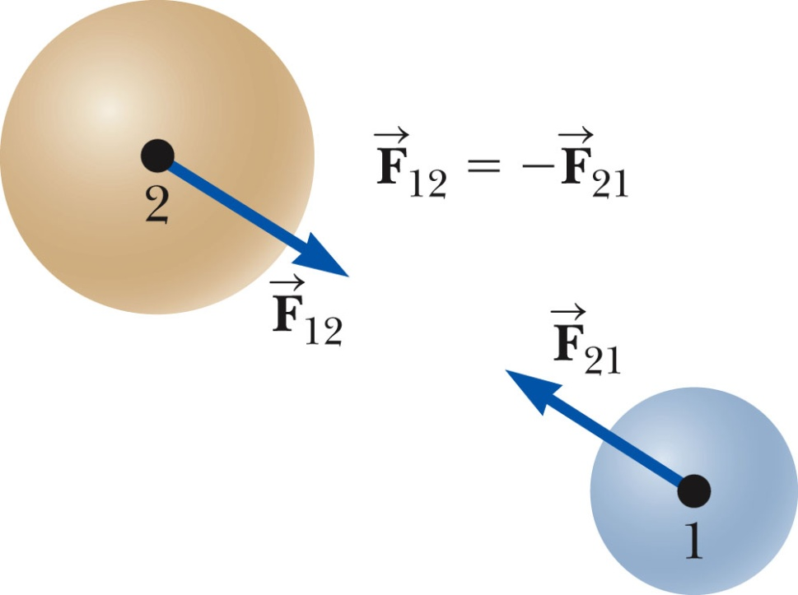




Newton’s Third Law
If two objects interact, the force exerted by object 1 on object 2 is equal in magnitude and opposite in direction to the force exerted by object 2 on object 1.
  Note on notation: is the force exerted by A on B.

Slide 25
Newton’s Third Law, Alternative Statement
The action force is equal in magnitude to the reaction force and opposite in direction.
  One of the forces is the action force, the other is the reaction force.
  It doesn’t matter which is considered the action and which the reaction.
  The action and reaction forces must act on different objects and be of the same type.

Slide 26
Action-Reaction, Example
The force exerted by object 1 on object 2 is equal in magnitude and opposite in direction to exerted by object 2 on object 1.

